Slide 1
Creating Presentations – A Checklist of Do’s and Don’ts
Matt Boles, Learning Specialist
mboles@brightcove.com

Slide 2
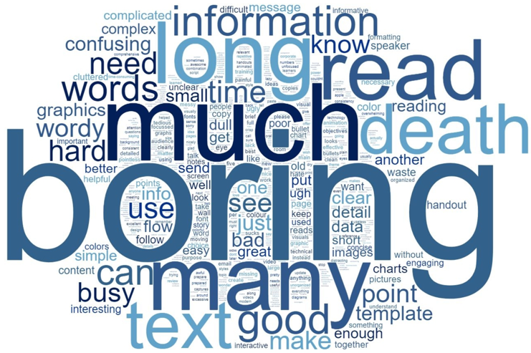
You Have a Challenges: 1. Word Cloud for Presentations

Slide 3

You Have a Challenges: 2. Your Time

Slide 4
What You Should Learn

Slide 5

Learning Points
DO Grab the Audience’s Attention
DON’T Annoy the Audience
DON’T Just Talk
DO Structure Presentation to Help Audience Learn
DON’T Overwhelm the Audience with Content

Slide 6
DO Grab the Audience’s Attention

Slide 7


Attention Grabbing Techniques
Use Humor or Element of Surprise
Involve the Audience / Make It Personal
Tell a Story
Use Cases
Demos
Ask Questions
Tips/
Tricks/Traps

Slide 8
DON’T Annoy the Audience

Slide 9
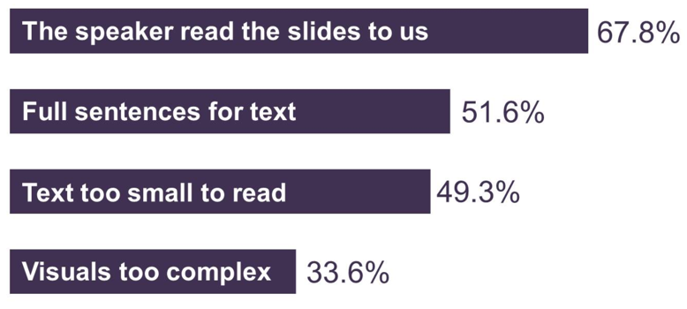
2017 Annoying PowerPoint Survey Results
Source: https://www.thinkoutsidetheslide.com/free-resources/latest-annoying-powerpoint-survey-results/

Slide 10
Presentation Tips from Apple
Grab Attention - Your audience will give you about 90 seconds to grab their attention – use an effective “hook”
Avoid bullet points - Use photos, images, and words
Create headlines - Don’t make hard to find the headline (or in our case, the learning point)
Source: forbes.com – 8 Presentation Techniques You Can Copy From Apple's WWDC Keynote

Slide 11
DON’T Just Talk

Slide 12
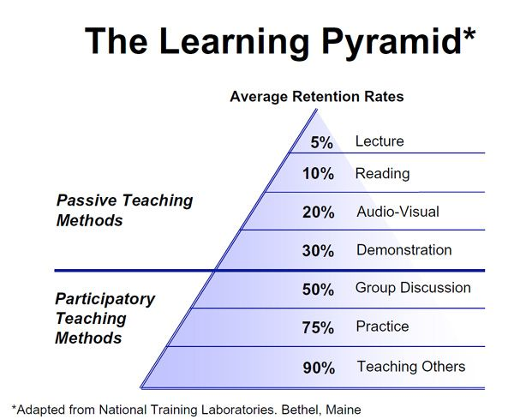
The Learning Pyramid
Because you speak about a topic, or show words about a topic, doesn’t mean it is learned

Slide 13
DO Structure Presentation to Help Audience Learn

Slide 14
Presentation Structure Increases Learning
STEP | JUSTIFICATION
Anticipatory Set | Focus students' thoughts on what will be learned
Objectives | Students learn more effectively when they know what they are supposed to be learning and why
Input | The new knowledge, process or skill must be presented in an effective manner
Modeling | It is important for students to "see" what they are learning
Checking for Understanding | It is important to make sure there is understanding of what was presented by asking questions
Guided Practice | The students need to practice the new learning under supervision
Closure | At the end of each topic it is important to review or wrap up the lesson by posing questions to check for successful learning
Source: Madeline Hunter’s Mastery Learning

Slide 15
But For Us …
STEP
Anticipatory Set
Objectives
Input
Modeling
Checking for Understanding
Guided Practice
Closure
Tell ‘em what you are going to tell ‘em
Tell ‘em
Tell ‘em what you told ‘em
Source: Madeline Hunter’s Mastery Learning

Slide 16

Use “Signposts” for Shifts in Topics
Presentation/public speaking technique to lead an audience through the different stages of your presentation
Examples
“I am now moving on to the next topic”
Show an demo of next learning point in action
Remember, you know the content and flow of your presentation, audience does not

Slide 17
DON’T Overwhelm the Audience with Content

Slide 18
Choose Topics That Can Be Presented Multiple Ways

Slide 19
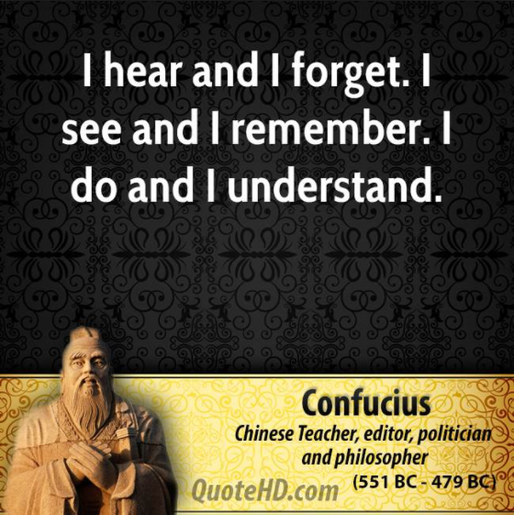
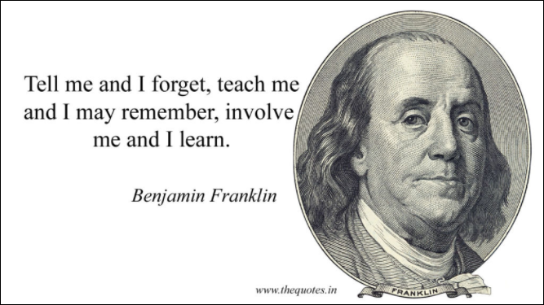
The Learning Pyramid Concept Is Not New

Slide 20
When It Comes to Content Selection …
DO: Teach fewer learning points that attendees remember
DON’T: Present many leaning points that are nearly immediately forgotten

Slide 21
Tell ‘Em What You Told ‘Em

Slide 22
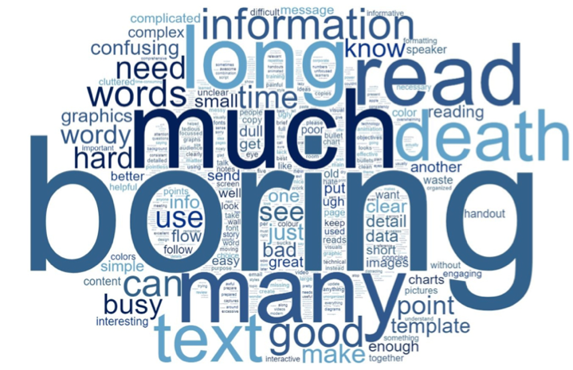

DO Grab the Audience’s Attention

Slide 23
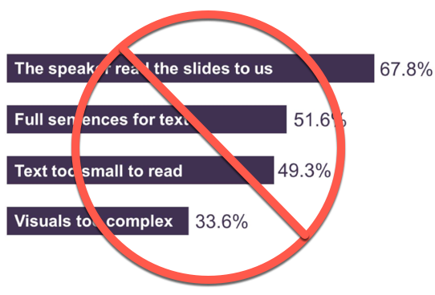
DON’T Annoy the Audience

Slide 24
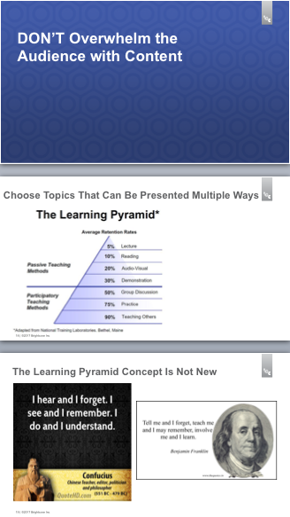
DON’T Just Talk

Slide 25
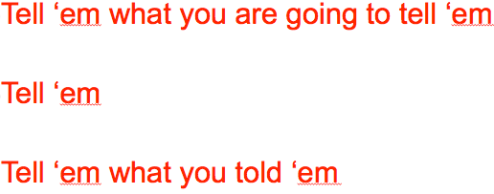

DO Structure Presentation to Help Audience Learn

Slide 26
DON’T Overwhelm the Audience with Content
Chose five essential learning points

Slide 27
Moving Forward

Slide 28
Major Sections for a PLAY Presentation
The “hook” – Grab attention – remember, you’ve got 90 seconds (at least demo what you are going to discuss)
State objectives/learning points – What major points should attendees learn
Content – Objectives/learning points material that teaches why/how
Review – All your major objectives/learning points reviewed
Q & A

Slide 29
Resources
Checklist for various To Do items and other resources
This presentation
A PLAY template will be supplied for use
List of royalty free photos/artwork/video (in checklist)
One Learning Services team member will review your presentation and work with you if improvements are needed

Slide 30
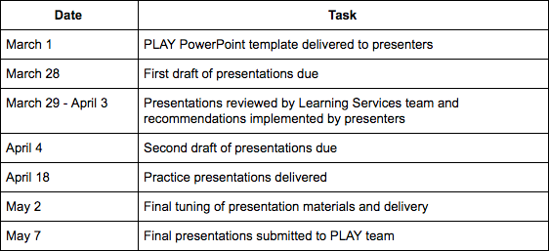
Moving Forward
Use the checklist when creating your PLAY presentations
Practice delivery of the presentation numerous times to ensure correct timing and smooth delivery
Timeline

Slide 31
Thank You!
Matt Boles
mboles@brightcove.com

